Slide 1
Applications of Statistical Analysis
Final Presentation
June 2024
Statistical Insights into Hypertrophic Cardiomyopathy via Diffusion Tensor Imaging
Kiryl Tarasenka

Slide 2
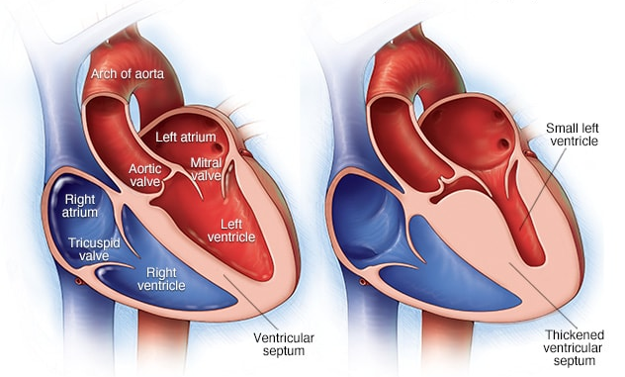

Slide 3
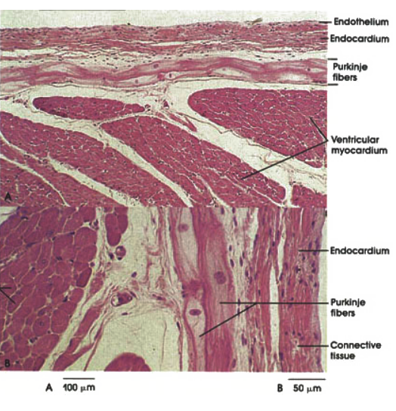
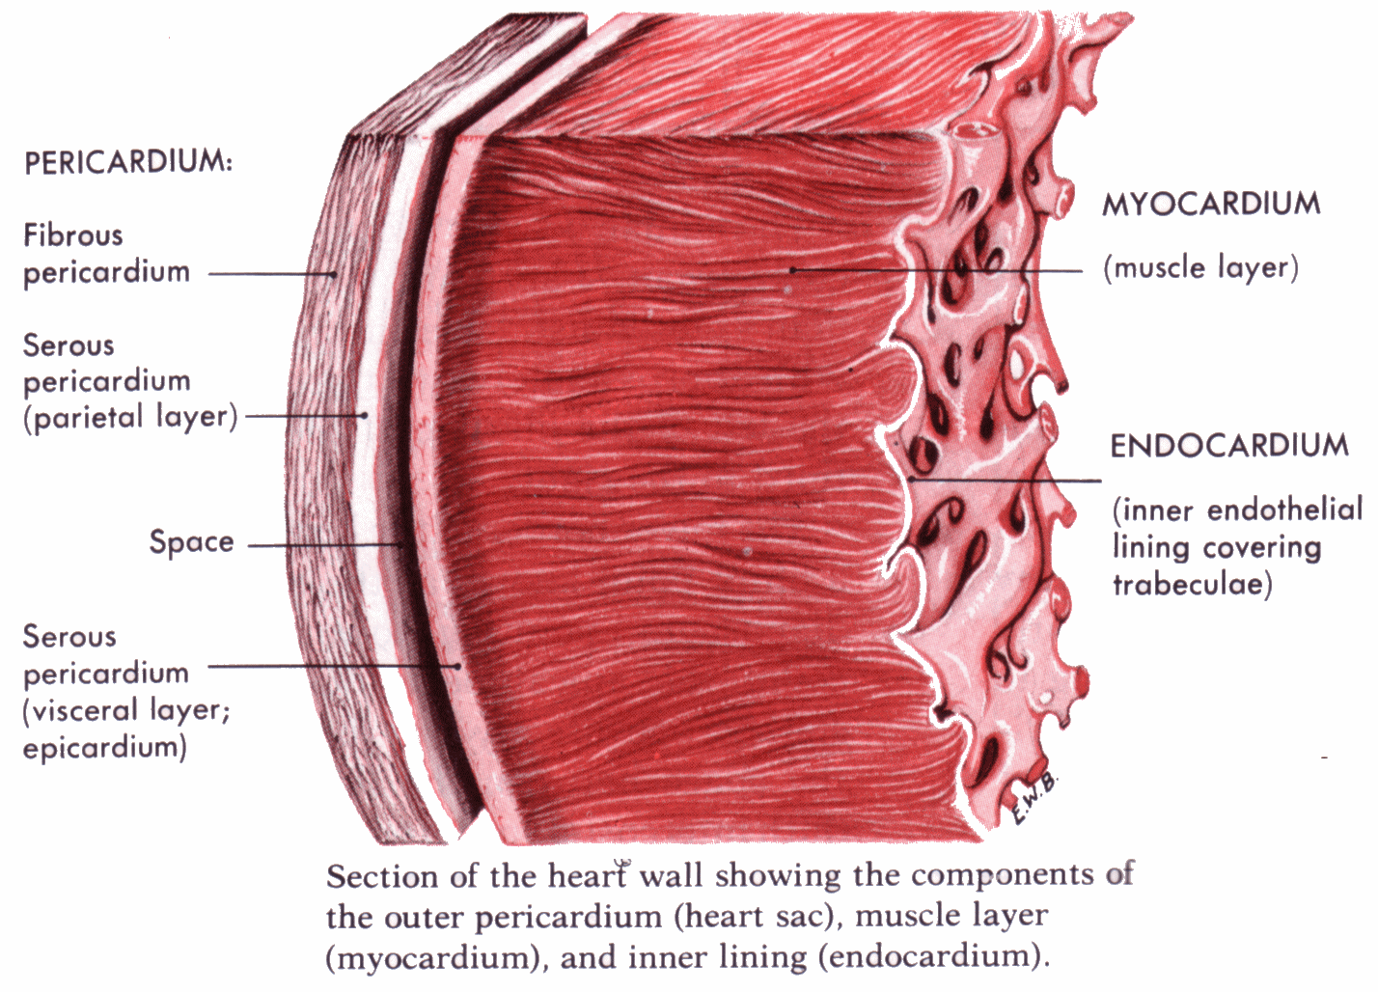
https://socratic.org/questions/the-bulk-of-the-heart-which-consists-of-cardiac-muscle-tissue-is-called-what

Slide 4
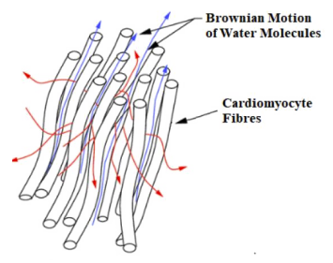
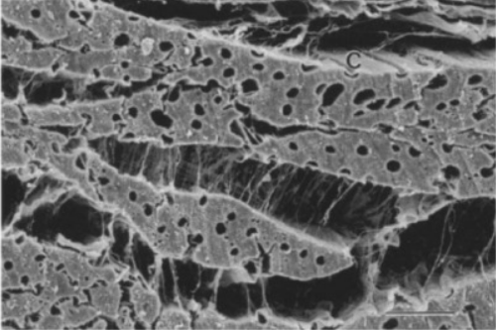
Cardiomyocytes and Sheetlets

Slide 5
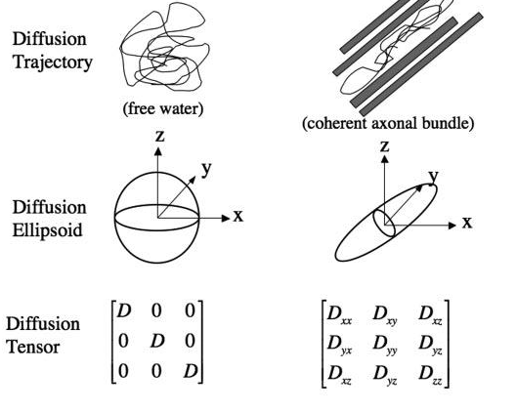
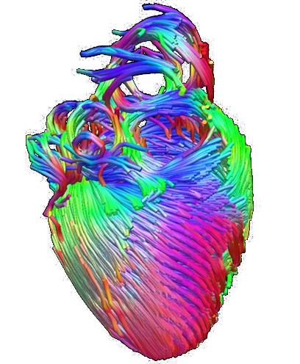

Slide 6
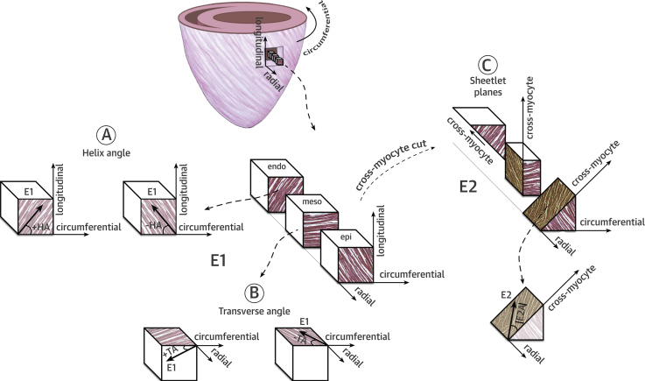

Slide 7
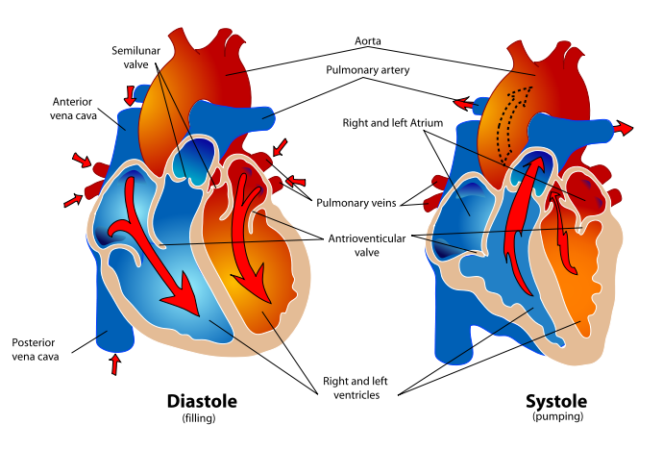
http://www.differencebetween.net/science/health/difference-between-systolic-and-diastolic/

Slide 8
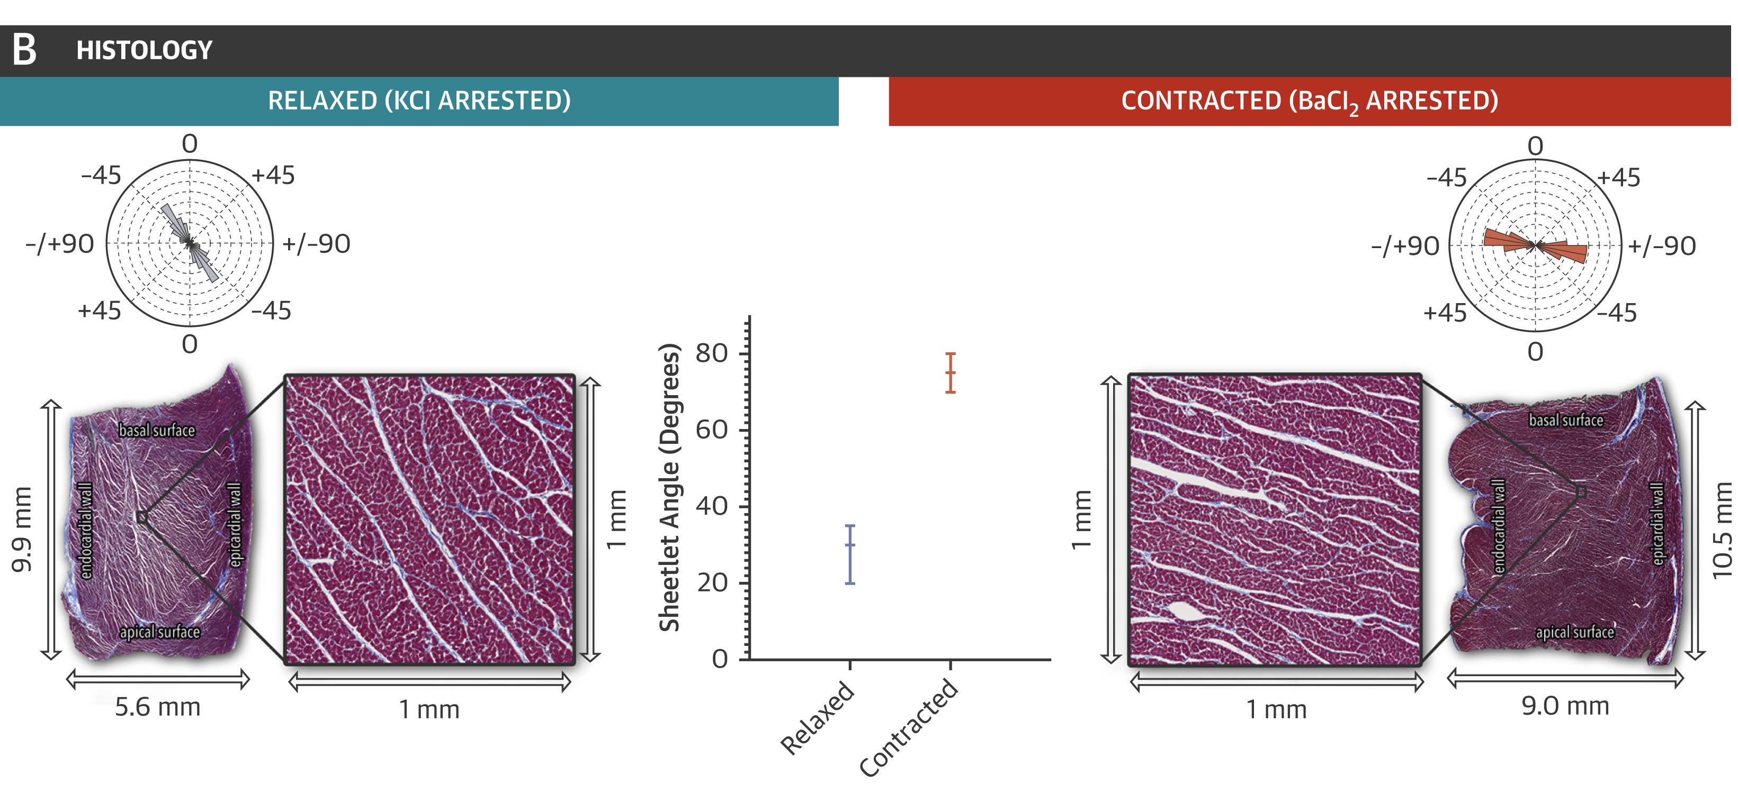

Slide 9
Left Ventricle
Right Ventricle
Ventricular Septum

Slide 10
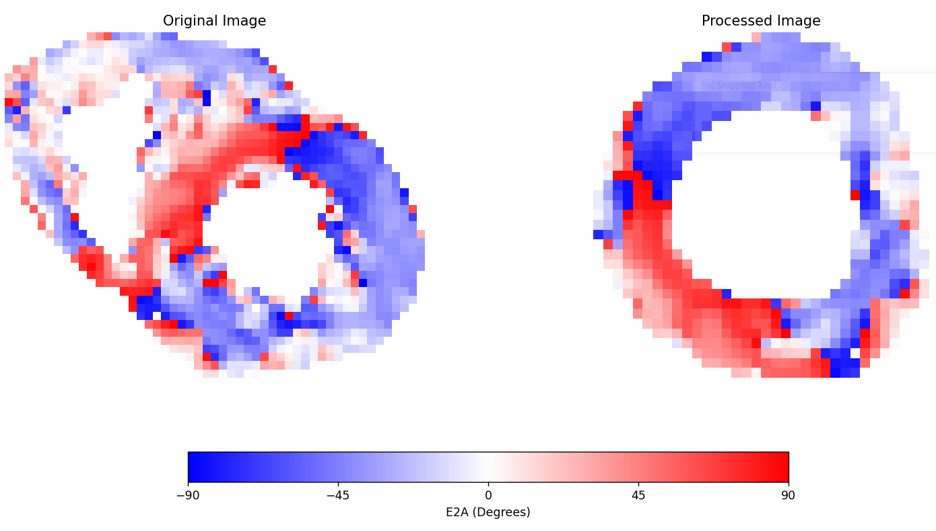

Slide 11
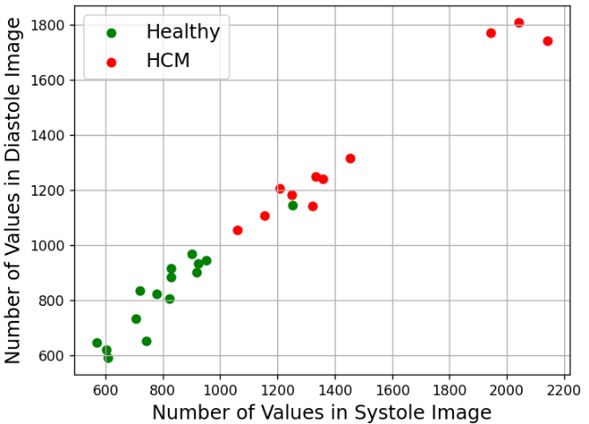

Slide 12
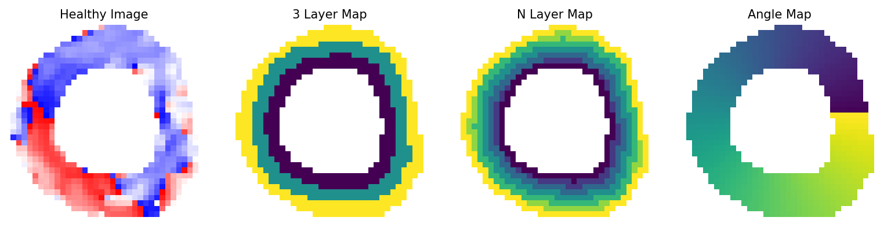

Slide 13
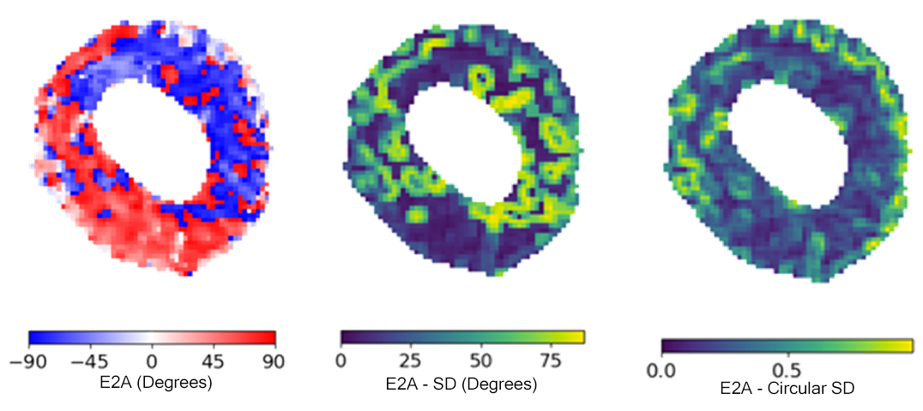

Slide 14


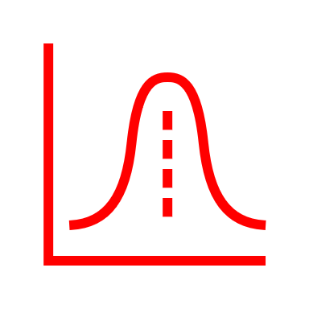

Total Healthy Distribution
Total HCM Distribution
Individual
Individual

Slide 15
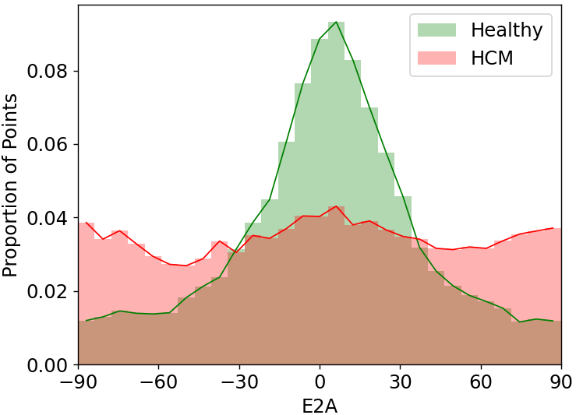
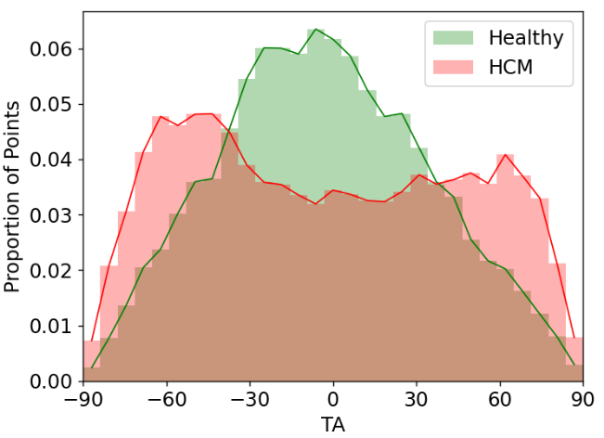
Diastolic E2A
Diastolic TA
Degrees
Degrees

Slide 16
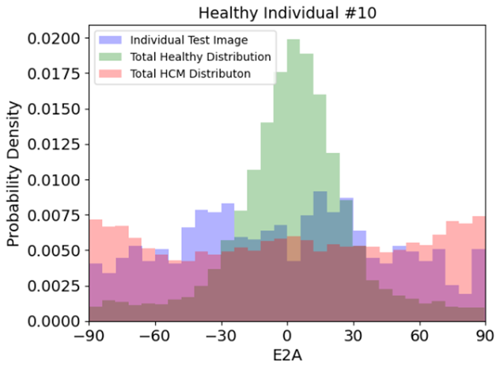
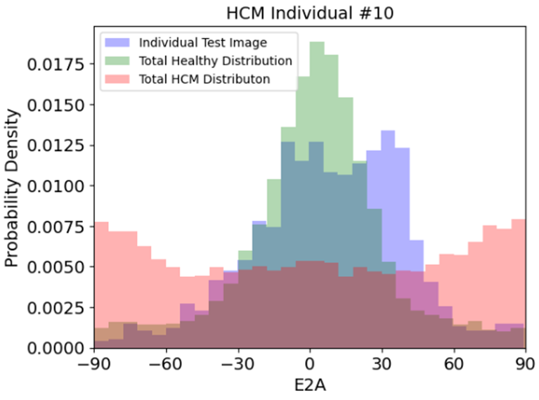
(E2A) Degrees
(E2A) Degrees

Slide 17
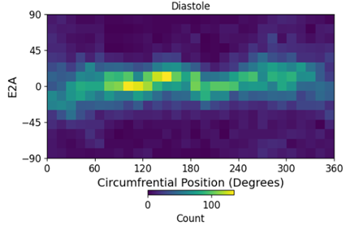
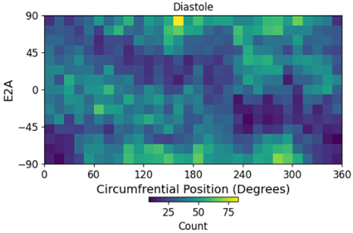

Slide 18
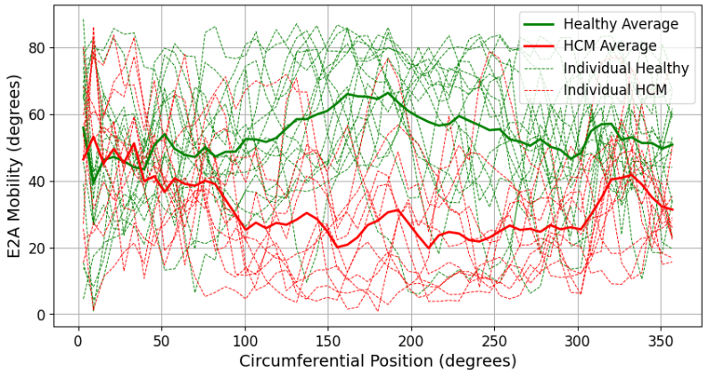

Slide 19
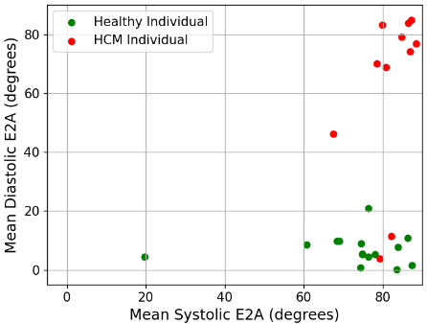

Slide 20
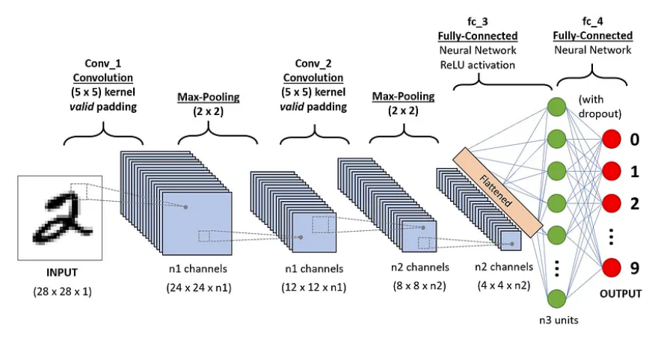

Slide 21
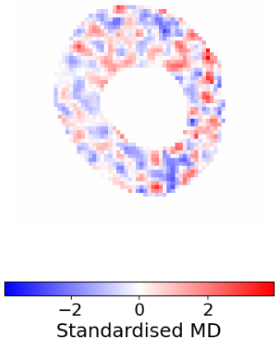
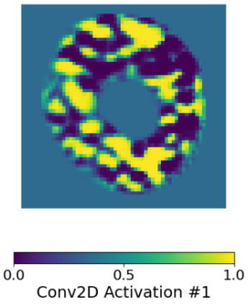
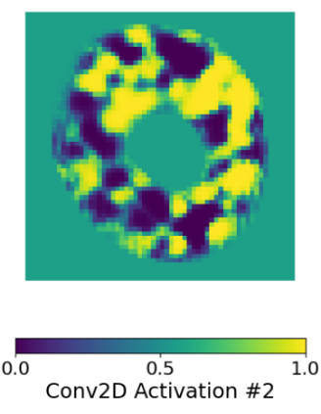
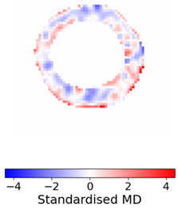
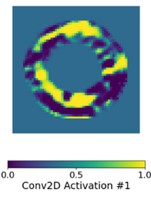
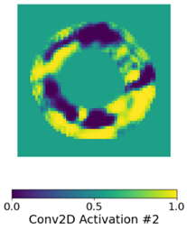

Slide 22
Conclusions

Slide 23
Appendix

Slide 24
References
Slide 2: Mayo Clinic. (2024) Hypertrophic Cardiomyopathy. https://www.mayoclinic.org/diseases-conditions/hypertrophic-cardiomyopathy/symptoms-causes/syc-20350198 [Accessed 11th June 2024]
Slide 3: Anatomy Atlas. (2022) Purkinje Fibers. https://www.anatomyatlases.org/MicroscopicAnatomy/Section08/Plate08151.shtml [Accessed 11th June 2024]
Slide 4 (left): Wassermann, Demian. (2010). Automated In Vivo Dissection of White Matter Structures from Diffusion Magnetic Resonance Imaging. Retrieved from https://www.researchgate.net/publication/281184102 [Accessed 11th June 2024]
Slide 4 (right), Slide 6, Slide 8: Khalique, Z., Ferreira, P.F., Scott, A.D., Nielles-Vallespin, S., Firmin, D.N. & Pennell, D.J. (2020) Diffusion Tensor Cardiovascular Magnetic Resonance Imaging: A Clinical Perspective. JACC: Cardiovascular Imaging. 13 (5), 1235-1255. https://doi.org/10.1016/j.jcmg.2019.07.016.

Slide 25
Slide 5 (left): Assadpour, T.M. (2012). Diffusion Tensor Imaging study for Multiple Sclerosis in the Optic Radiation. Retrieved from https://www.researchgate.net/publication/256701551 [Accessed 11th June 2024]
Slide 5 (right): Healthcare-In-Europe. (2015). Diffusion tensor MRI. https://healthcare-in-europe.com/en/news/diffusion-tensor-mri.html [Accessed 11th June 2024]
Slide 7: Naigaonkar M. (2015). Differences between Systolic and Diastolic. http://www.differencebetween.net/science/health/difference-between-systolic-and-diastolic/ [Accessed 11th June 2024]
Slide 20: Sahit, S., (2018). A Comprehensive Guide to Convolutional Neural Networks — the ELI5 way. https://towardsdatascience.com/a-comprehensive-guide-to-convolutional-neural-networks-the-eli5-way-3bd2b1164a53 [Accessed 3rd April 2015]

